Slide 1
QUANTUM COMPUTING - a step to the next generation
PRESENTED BY:
Sivaneshmurugasamy
1 st year M.SC., (CT-PG)
KONGU ENGINEERING COLLEGE
ERODE.

Slide 2
1. INTRODUCTION
Quantum computing is a new and exciting field that intersects mathematics, computer science, and physics.
Computer systems built on the principles of quantum mechanics are capable of performing calculations deemed unachievable for classical computers.
This paper provides an overview and history of quantum computing, discusses its algorithmic mechanisms, and explores its implications for cryptography, innovation, power structures, and day-to-day life

Slide 3
1.1 what is quantum mechanics?
Quantum mechanics is a subfield of physics that describes the behavior of particles — atoms, electrons, photons and almost everything in the molecular and submolecular realm.
The quantum realm is the area in which the atoms and particles are at the smallest size they can be.
This size is typically around 100 nanometers(10 - 9 meters) or less.
It is in this realm that the fundamentals of quantum computing or built.

Slide 4
1.2 what is quantum computing?
Quantum computing is made up of qubits.
Unlike a normal computer bit, which can be 0 or 1, a qubit can be either of those, or a superposition of both 0 and 1.
The power of quantum computers grows exponentially with more qubits.
This is unlike classical computers, where adding more transistors only adds power linearly.

Slide 5
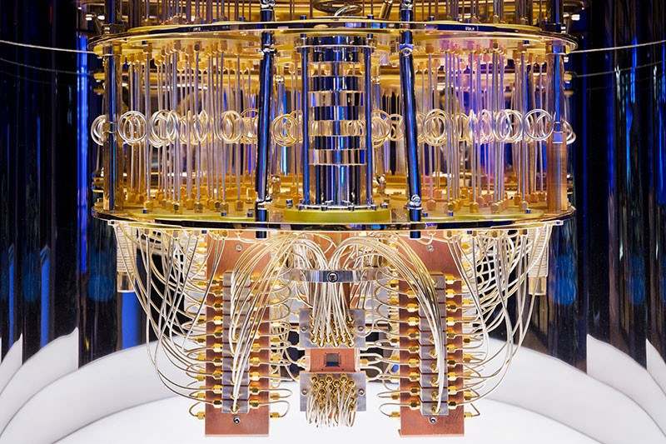
Pictorial representations of quantum computer.

Slide 6
2.1 BITS
Computer handles data in form of ‘0’ and ‘1’.
Any kind of data like number,alphabet,special characters should be converted into ‘0’ and ‘1’ which can be understood by the computer.
’0’ and ‘1’ that the computer can understand is called Machine language.
’0’ and ‘1’ are called Binary Digit.
Bit is a short form of Binary digit which can be ‘0’ and ‘1’.
It is the basic unit of the data in the computer.

Slide 7
2.2 QUBITS
Qubit is a quantum bit,the counter part in quantum computing.
Qubit is used in quantum computer.
Qubits which have value of either 0 or 1(0 & 1) at the same time.
In a quantum computer,a number of elemental particles such as electrons or photons can be used.
The nature and the behaviour of these particles form the basis of quantum computing.
The two most relevant aspects of quantum physics are the principles of superposition and Entanglement.

Slide 8
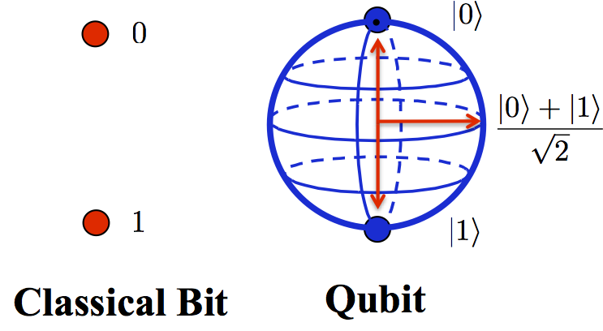

BITS QUBITS

Slide 9
3.1 DIFFERENCE BETWEEN CLASSICAL COMPUTER AND QUANTUM COMPUTER?
CLASSICAL COMPUTOR
QUANTUM COMPUTER
works on bits which can have value of either 0 or 1.
Uses AND,OR,NOT,XOR gates.
Based on basic mathematical operations on binary.
Can solve many real life problems but lack when it comes to optimisation,simulation,etc..on high scale.
Works on qubits which can value of either 0 or 1(0&1)at the same time.
Uses H,X,CX,CZ,u3,etc gates.
Based on quantum physics principle.Based on the nature of electrons.
Quantum computers are very good at optimisation,simulation etc.it can process multiple possibilities in one shot.

Slide 10
3.2 Benefits of quantum computer
It is mainly used in the fields of finance,military affairs,and intelligence,drug design, and discovery,aerospace designing,etc..,
Information storage pattern.
Speed.
Security.
Power efficient.
AI.

Slide 11
3.3 COMPANIES THAT DEVELOPED QUANTUM TECHNOLOGY
IBM
QCI
XANADU
MICROSOFT AZURE QUANTUM….
D-WAYS SYSTEM….

Slide 12
4.1 HOW IT SERVES IN FUTURE?
it is envisioned that quantum computing
will accelerate us into the future by
impacting the landscape of artificial
intelligence and data analytics.
the quantum computing power and speed
will help us solve some of the biggest and
most complex challenges we face as
Humans.

Slide 13
Thank you

